Slide 1
President’s Opening Remarks
Kostas Plataniotis, President, IEEE Signal Processing Society
ICASSP 2025, Hyderabad, India

Slide 2
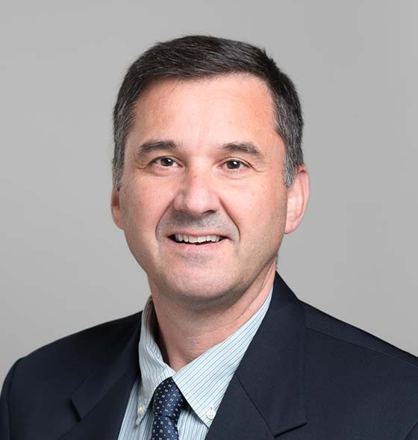
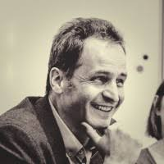
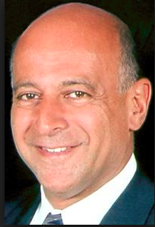
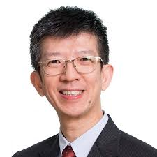
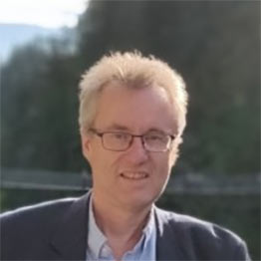
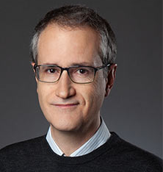
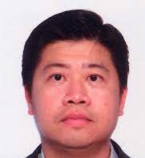
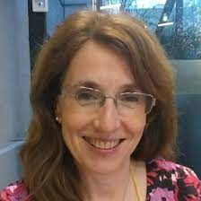
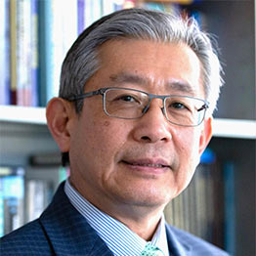
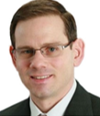
SPS: Under the Hood
Members
Executive Committee*
Board of Governors
Kostas Plataniotis*
President
Marc Moonen*
President-Elect
Rich Baseil*
Executive Director
Haizhou Li*
Frederic Dufaux*
Antonio Ortega*
Kenneth Lam*
Roxana Saint-Nom*
K.J. Ray Liu
Anthony Vetro
Conferences Board
Technical
Directions Board
Publications Board
Membership Board
Education
Board
Awards
Board
Industry
Board
Standing Committees
Learn More at https://bit.ly/bogsps

Slide 3
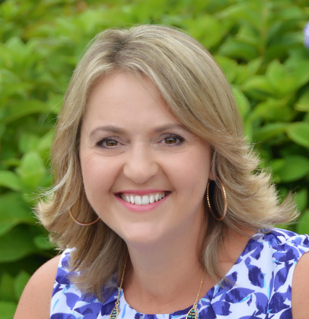
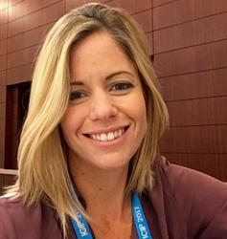
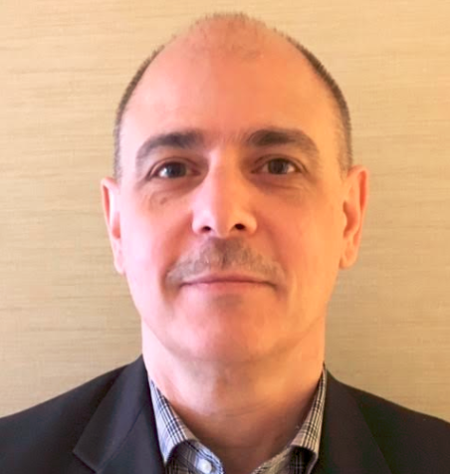
IEEE Signal Processing Society Staff
Rich Baseil
Executive Director
Theresa Argiropoulos
Director, Operations
Caroline Johnson
Director, Conferences, Marketing, and Data Analytics
William Colacchio
Director, Publications & Education Strategy and Services
Conferences, Marketing, and Data Analytics
Alisa Abraham, Strategic Conference Manager
Nicole Allen, Senior Conference Administrator
Samantha Esposito, Conference Administrator
Dena Watkins, Marketing Analytics Manager
Membership & Operations
Deborah Blazek, Senior Administrator, Governance & Awards
Peggy Lanza, Temporary Operations Assistant
Nikki Leske, Communications & Experience Manager
George Olekson, Membership & Chapters Senior Administrator
Jaqueline Rash, Membership Program & Events Manager
Publications & Education
Rupal Bhatt, Web Administrator
Breanna Cameron, Peer Review & Education Program Administrator
Michelle Demydenko, Education Program Manager
Nanette Januszkiewicz, Peer Review & Education Program Administrator
Mikaela Langdon, Peer Review & Education Program Administrator
Rebecca Wollman, Senior Publications Peer Review Support Specialist

Slide 4
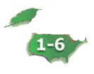
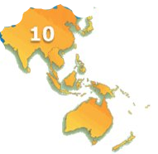
+

Slide 6
Strategic Vision
Aims to create an inclusive, open-minded, and collaborative environment that serves as the professional home for all members’ career development and promotes technical excellence and technological & societal impact
Lead
in technical excellence and expand scientific knowledge in new areas
Increase
engagement of industry and early-career members and cultivate volunteer development
Develop
high-quality professional educational training to support lifelong learning
Share your thoughts to shape our plan & actions together at https://bit.ly/spsideas
Evolve
our organizational structure and technical scope to meet current and future challenges
Reinforce
fairness for members & volunteers

Slide 9
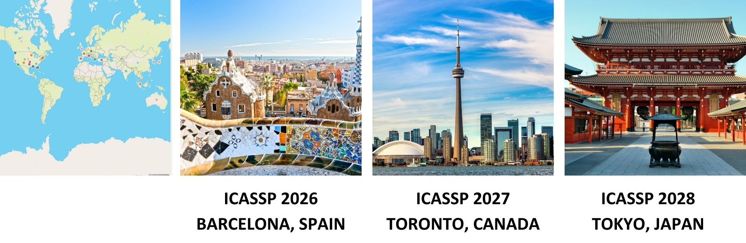
Join Us at ICASSP For Years To Come!

Slide 10
IEEE Education Week 2025: This Week @ ICASSP
Growing educational portfolio at SPS
SigPort: post your slides & posters
Resource Center: video talks & tutorials
Mentoring activities: micro mentoring @ ICASSP/ICIP
Short courses: 4th year @ ICASSP
Curation: SP course weblinks, textbooks, lecture material, etc.

Slide 11
Educational Short Courses at ICASSP 2025
6-9 hours courses held over two days
Designed to offer an in-depth, multi-faceted understanding of a topic, including hands-on experience
Participants will receive course materials and a professional development certificate
The fee is per course, and registration for the main conference is not required to attend the short courses
A Signal Processing Tour of High-Dimensional
Estimation and Learning: Results, Techniques, and Applications
Dates and Time: April 6, 2025 (Sunday): Full Day/6 hours
Phase Processing of Speech Signals
Dates and Time:
April 6, 2025 (Sunday): Full Day/6 hours
April 7, 2025 (Monday): Afternoon/ 3 hours
Spherical Visual Signal Processing: A Primer
Dates and Time:
April 6, 2025 (Sunday): Full Day/6 hours
April 7, 2025 (Monday): Forenoon/3 hours
Estimation Performance Bounds in Signal Processing
Dates and Time:
April 6, 2025 (Sunday): Full Day/6 hours
April 7, 2025 (Monday): Forenoon/ 3 hours
Thank you to all the course instructors,
SPS Education Board, and contributors!

Slide 12
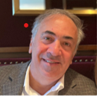
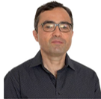
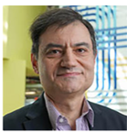
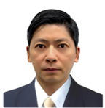
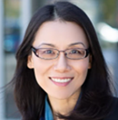
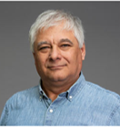
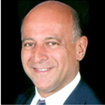
Industry Board Objective: The Industry Board was created to bridge the gap between the society and technology industry. The Board strives to make the society more reflective of industry perspectives and increase industry participation in all society endeavors including memberships, partnerships, and sponsorships.
Anthony Vetro
Industry Board Chair
Mitsubishi Electric Research Labs
Alex Acero
Apple
Onur G. Guleryuz
Google LLC
Ioannis Katsavoundidis
Meta
Jianquan Liu
NEC Corporation
Shan Liu
Tencent
Ivan Tashev
Microsoft Research
Rich Baseil
Executive Director
IEEE Signal Processing Society

Slide 14
Membership Opportunities for Everyone
Accessible pricing for our growing membership to Developing Nations, Low-Income Economies and Students
Half-Price Memberships In Effect Until 15 August!
Essential Membership | Preferred Membership | Developing Nations | Low Income Economies
US$22 /year | US$39 /year | US$11 /year | US$4 /year
$1 membership fee for student and graduate student members
Visit the IEEE website for list of eligible countries; Discounted Society pricing available only to IEEE electronic members on Society essential package
Notes:
https://www.ieee.org/membership/join/emember-countries.html

Slide 15
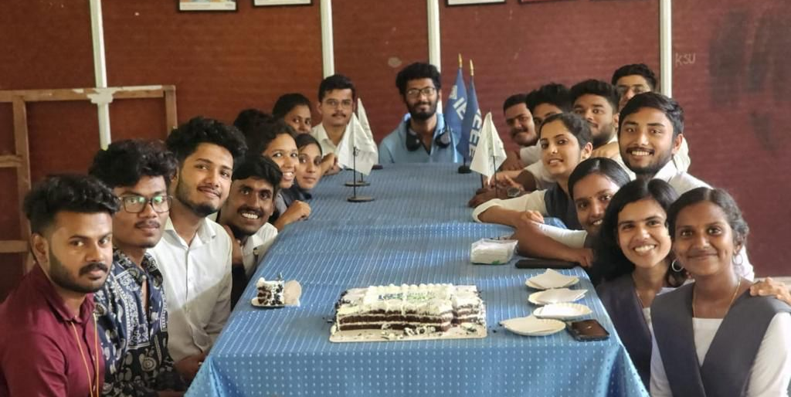
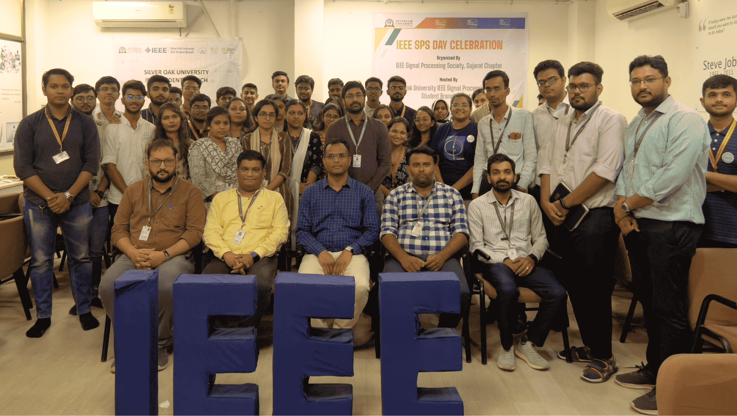
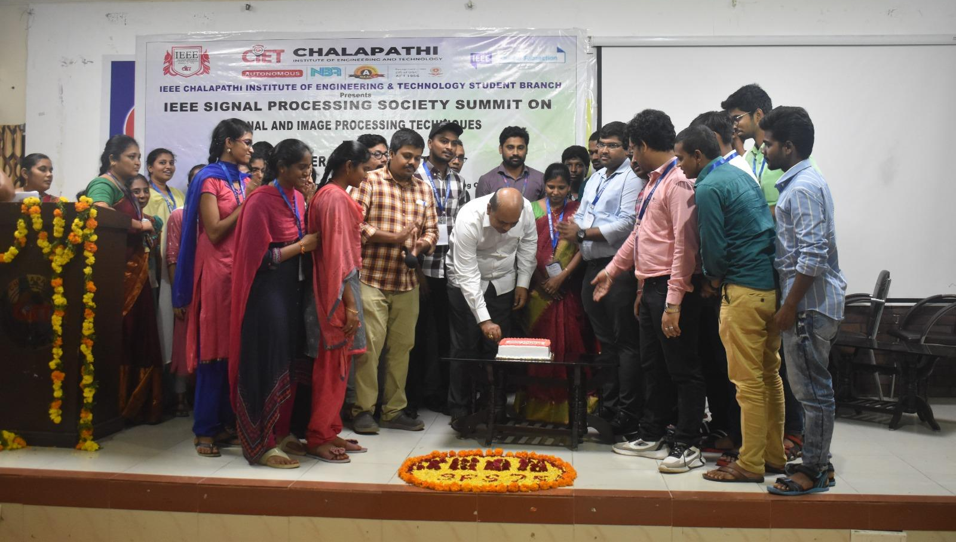
.
June 2 spsday.ieee.org
Celebrating the SPS Birthday → Formed 2 June 1948
Global celebrations since ’23 inaugural for SPS impact, history, and communities by members/chapters
Organize SPS Day event for 2025 around you
Hold events two weeks before/after 2 June tagged #SPSDay
Submit pictures of your event in the SPS Day Photo Contest

Slide 16
Stay in touch with SPS
Share your experience using the conference hashtag:
#ICASSP2025
Follow @ieeeICASSP on Facebook and Twitter for more news about ICASSP 2025 and beyond!
@ieeeSPS

Slide 17
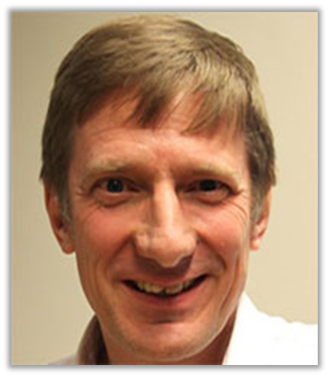
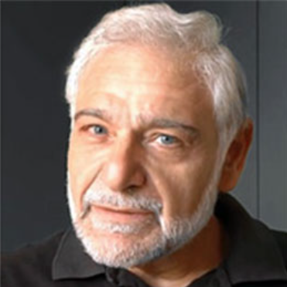
Thank you for your service!
Alle-Jan van der Veen
Vice President- Technical Directions
Sergios Theodoridis
Awards Board Chair
And retiring Regional Directors and Members-at-Large of the Board of Governors, Editors-in-Chief, TC Chairs, past conference chairs, and many editors and committee members.

Slide 18
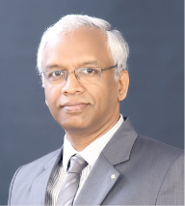
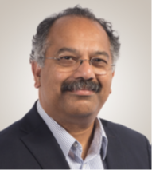
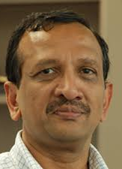
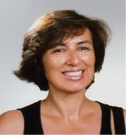
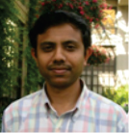
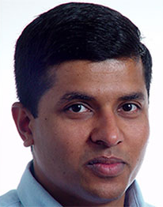
A Big Thank You to the 2025 ICASSP General Chairs and Technical Program Chairs
K.V.S. Hari General Chair
IISc, India
V John Mathews General Chair
Oregon State Univ., USA
Bhaskar D Rao
Technical Program Chair UCSD, USA
Isabel Trancoso
Technical Program Chair Univ. of Lisbon, Portugal
Neelesh B. Mehta Technical Program Chair
IISc, India
Gaurav Sharma
Technical Program Chair Univ. of Rochester, USA

Slide 19
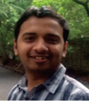
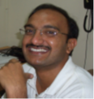
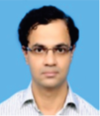
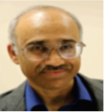
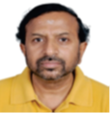
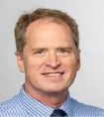
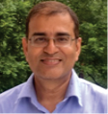
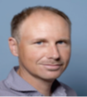
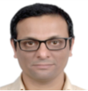
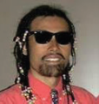
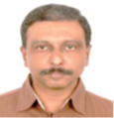
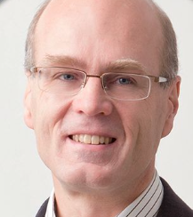
A Big Thank You to the ICASSP 2025 Committee

